Slide 1
Sleep or Awake Classification Using Machine Learning with ECG Signal Datasets
Dharanesh P [CB.EN.U4CCE23009]
Jayanth CR [CB.EN.U4CCE23018]
K B Vishal [CB.EN.U4CCE23019]

Slide 2
2
PROGRESS OVERVIEW
Dataset Understanding and Structure:
Explored the PhysioNet 2018 dataset and identified key components such as ECG signals, annotations for sleep stages, and arousals (events when sleep is disturbed).
Found that the signals are named (e.g., F3-M2, F4-M1) and recorded at a frequency of 200 times per second (200 Hz).
Development Environment Setup:
Installed necessary libraries like WFDB, h5py, NumPy, and Matplotlib to set up the environment for analysis.
Ensured compatibility with working on ECG signals and their annotations.
Exploring the Dataset:
Loaded and examined the ECG signal records and annotations using WFDB.
Analyzed the arousal data to understand the types of arousals and their timing.
Visualized the first 5 seconds of the each signal to better understand the data.

Slide 3
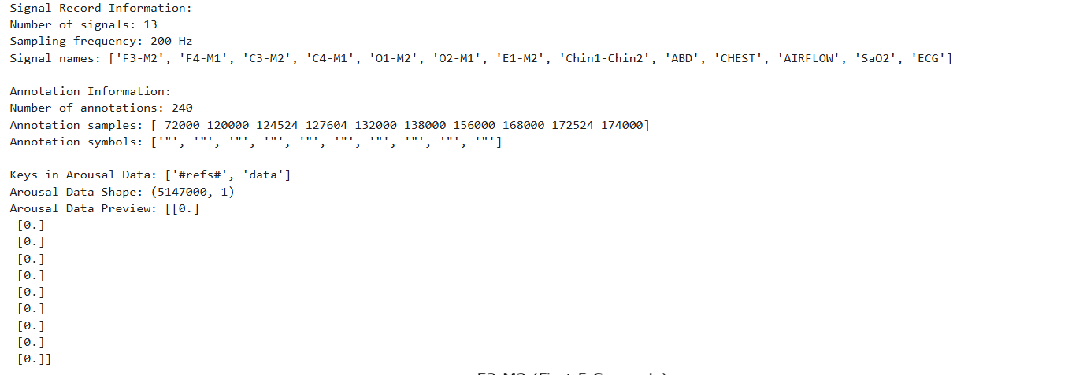
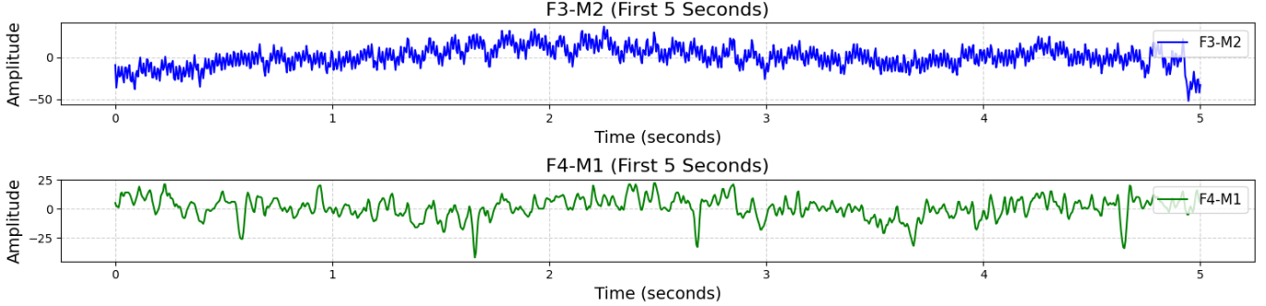
Understanding the Database

Slide 4
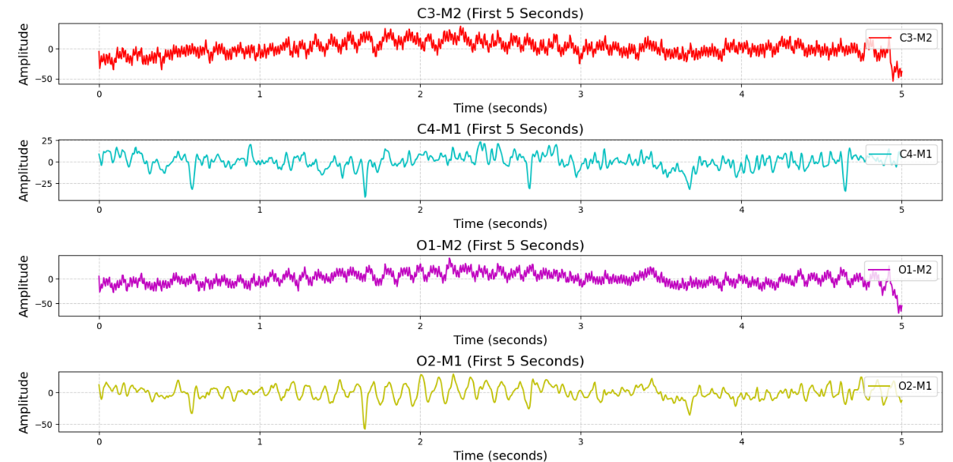
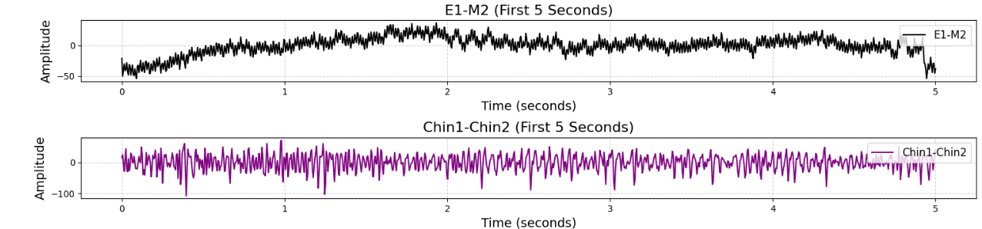

Slide 5
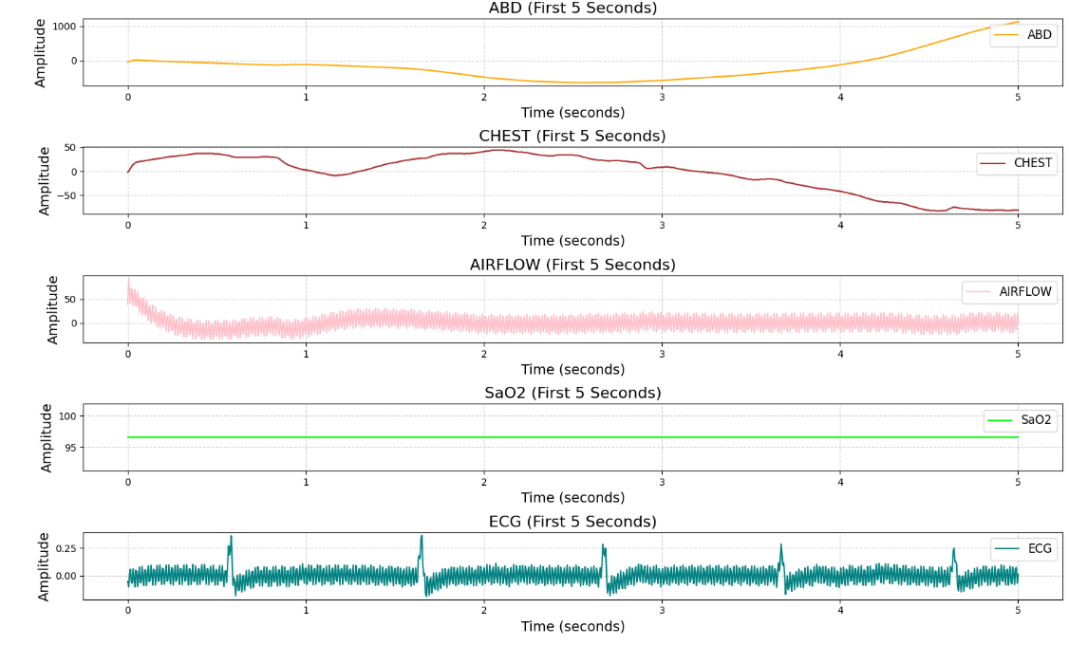

Slide 6
The above is done on a sample data named tr03-005
Signal Record Information:
13 signals recorded at 200 Hz.
Includes EEG (e.g., F3-M2, F4-M1), muscle activity (e.g., Chin1-Chin2), airflow, oxygen saturation, and ECG.
Annotation Information:
240 annotations marking events like sleep arousals.
Annotations provide important information about when sleep stages change or when arousals occur, which are critical for analyzing sleep quality.
The 240 in the annotation information refers to the number of annotation points in the dataset. In this case, it means there are 240 distinct annotations marking specific events (like arousals, sleep stages, or other disturbances) within the dataset.
Arousal Data:
Arousal data shape: 5.1 million time points.
Preview shows 0s, likely indicating no arousal, with changes marking arousals during sleep.

Slide 7
INFORMATION ABOUT THE SIGNALS:
E1-M2: EEG signal detecting eye movement, useful for identifying Rapid Eye Movement (REM) sleep.
Chin1-Chin2: EMG signal measuring chin muscle activity, useful for detecting teeth grinding and muscle tension during sleep.
F3-M2, F4-M1, C3-M2, C4-M1, O1-M2, O2-M1: EEG signals recording brain activity from different regions, helping identify sleep stages and brain wave patterns.
ABD: Measures abdominal muscle activity to track respiratory movements during sleep.
CHEST: Measures chest muscle activity to monitor breathing and respiratory effort during sleep.
AIRFLOW: Measures airflow through the nose and mouth to assess breathing patterns and identify disruptions like apnea.
SaO2: Measures blood oxygen saturation levels, indicating how well the lungs oxygenate the blood during sleep.
ECG: Electrocardiogram signal monitoring heart activity, detecting heart rate and rhythm during sleep.

Slide 8
Data preprocessing
Objective: Prepare ECG data for accurate model training and testing
What We Did:
Ensured data consistency and quality
Verified data completeness (No missing values found)
No noises found and
Organized datasets for efficient processing and the dataset was already clean.
Outcome:
Data is clean and ready for feature extraction and model training.

Slide 9
Splitting datasets
Objective: Prepare data for training and evaluating the model
What We Did:
We split dataset into 60% for training and 40% for testing.
Then, we removed the labels column (which contains the sleep(0)/awake(1) information) from both the training and testing datasets to ensure that the model doesn't have access to the labels during training.
After that, we combined the data together (without the labels) to prepare it for feature extraction and model training. And stored the labels in a separate file as ‘y_train’ and ‘y_test’.
Why We Did It:
Splitting the dataset into 60% for training and 40% for testing provides a good balance between training the model (with enough data to learn) and evaluating its performance on unseen data.
By removing the labels column from the datasets before training, we ensure that the model only learns from the features and not from the target labels, which helps prevent data leakage and ensures fair evaluation.
Outcome:
Data is organized for reliable model training and testing

Slide 10
Feature Extraction
Objective: We aimed to extract key features from ECG data to enhance sleep vs. awake classification performance.
What We Did:
HRV Feature Extraction
Extracted detailed Heart Rate Variability (HRV) features to provide additional insights.
Helps in analyzing heart rate changes, which differ between sleep and wakefulness.
Better Peak Detection & Signal Processing
Applied ECG signal cleaning to improve R-peak detection.
Ensured more accurate HRV calculations, leading to better feature reliability.
Automated Data Handling
Rows with missing or insufficient HRV data were automatically removed.
Prevented incomplete or noisy data from affecting classification.
Batch Processing for Efficiency
Automated feature extraction for multiple ECG files at once.
Real-time progress tracking for improved workflow management.
More Comprehensive Features
Combined traditional statistical features (Mean, Std, Min, Max, Skewness, Kurtosis) with HRV features.
Provides a broader representation of ECG signal behavior for classification.

Slide 11
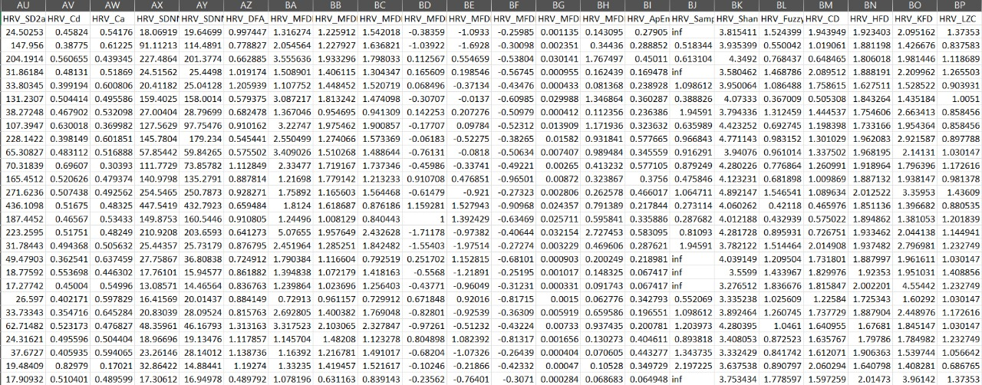
Feature Extraction
Raw ECG data by itself doesn’t provide enough information for accurate classification. By extracting statistical, shape, and peak features, we gain better insights into the data, which aids in classification.
These extracted features help improve the performance of machine learning classifiers (Decision Tree, Random Forest, SVM) in detecting sleep vs. awake states.

Slide 12
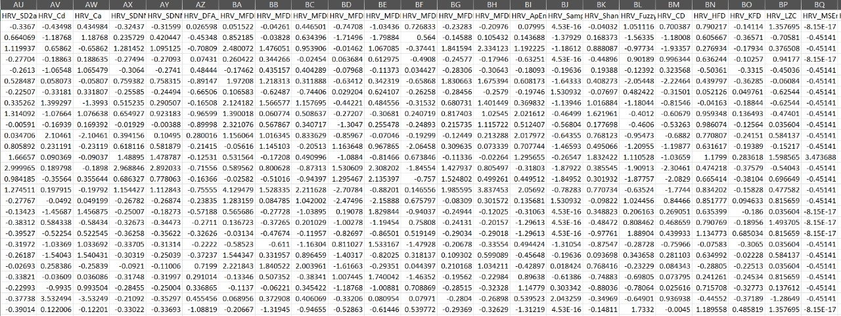
Normalization
Why Normalization?
Standardizes feature scales to prevent dominance by large values.
Ensures all features contribute equally to classification.
What Was Done?
Scaled features to a consistent range using normalization.
Improved model performance by enabling faster convergence and reducing bias.
Ensured consistency by applying the same transformation to training and testing data.

Slide 13
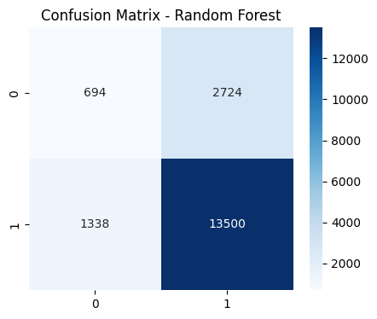
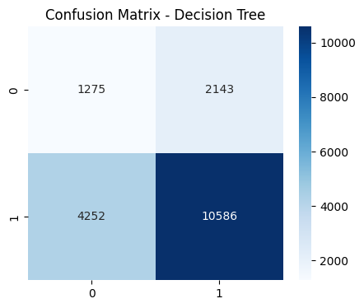
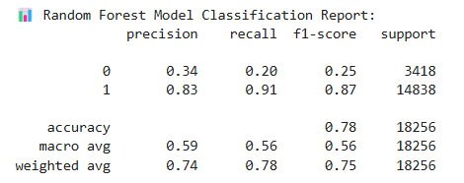
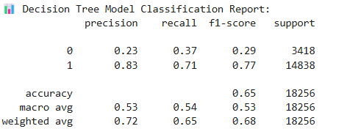
Model Performance Analysis

Slide 14

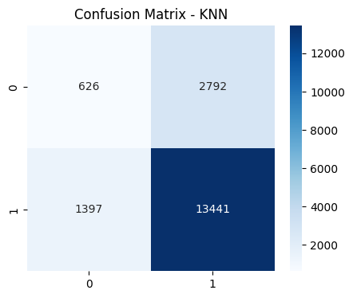
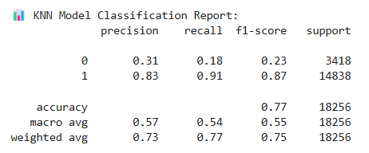
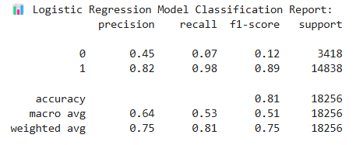
Model Performance Analysis

Slide 15


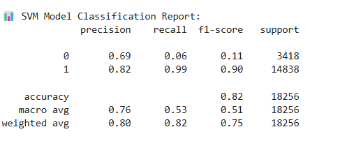
Model Performance Analysis
Accuracy: 0.80
Precision: 0.80
Recall: 1.00
F1-Score: 0.89

Slide 16
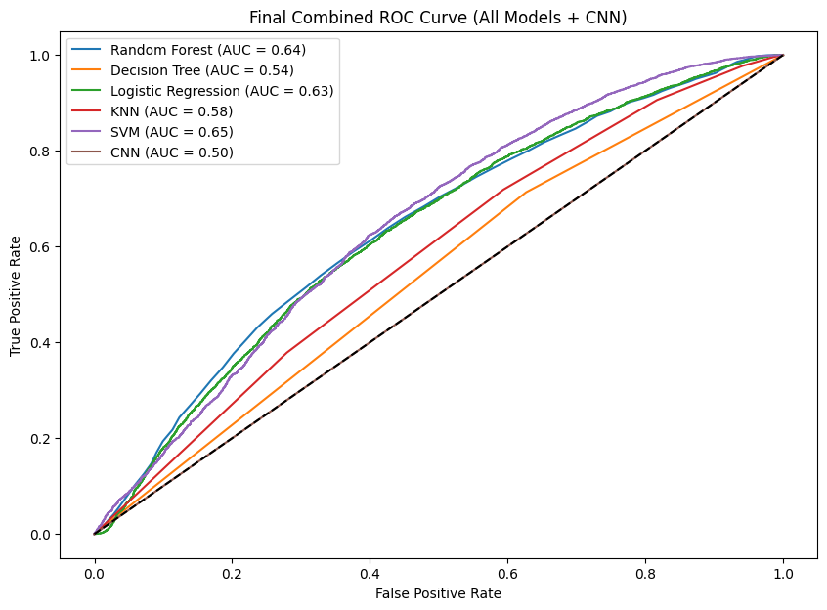
Model Performance Analysis

Slide 17
Model Performance Analysis
Algorithm | Accuracy | F1-Score | Precision
Random Forest | 78% | 0.75 | 0.74
Decision Tree | 65% | 0.68 | 0.72
Logistic Regression | 81% | 0.75 | 0.75
KNN | 77% | 0.75 | 0.73
SVM | 82% | 0.75 | 0.80
Key Observations:
SVM Performs Best:
Highest accuracy (82%) and precision (80%), indicating strong classification ability.
Logistic Regression Also Performs Well:
Accuracy (81%) is close to SVM, with balanced F1-score (0.75) and precision (0.75).
Random Forest & KNN Show Moderate Performance:
Random Forest (78%) and KNN (77%) perform similarly, with stable F1-scores.
Could benefit from hyperparameter tuning for better generalization.
Decision Tree Has the Lowest Accuracy:
65% accuracy, suggesting it may overfit or struggle with feature complexity.

Slide 18

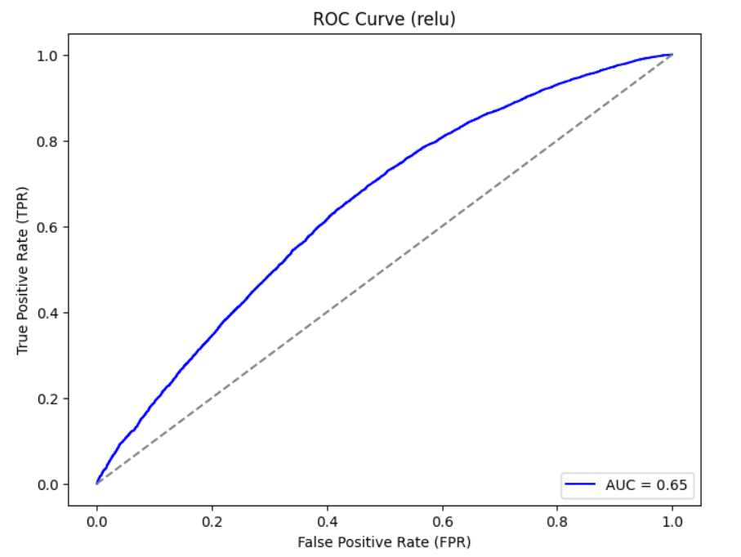
Model Performance Analysis
ANN(ReLU)

Slide 19
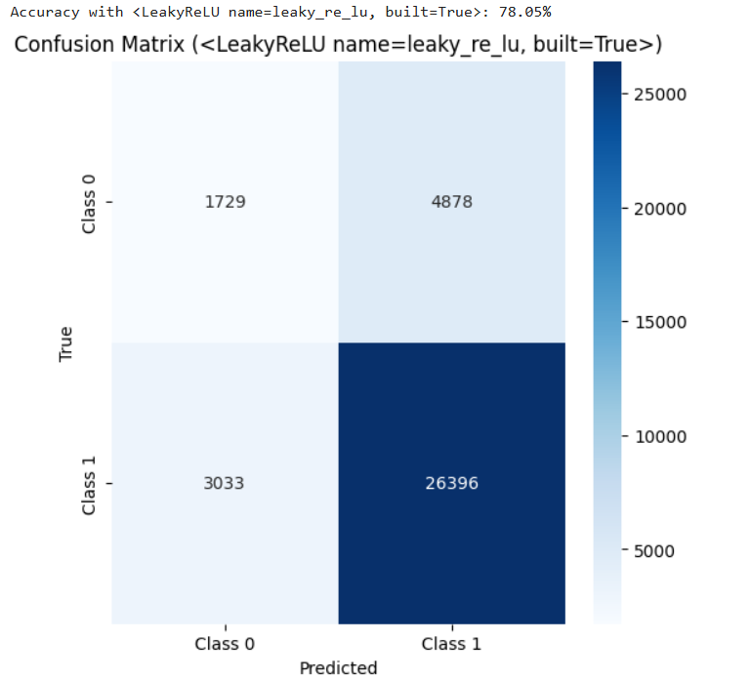
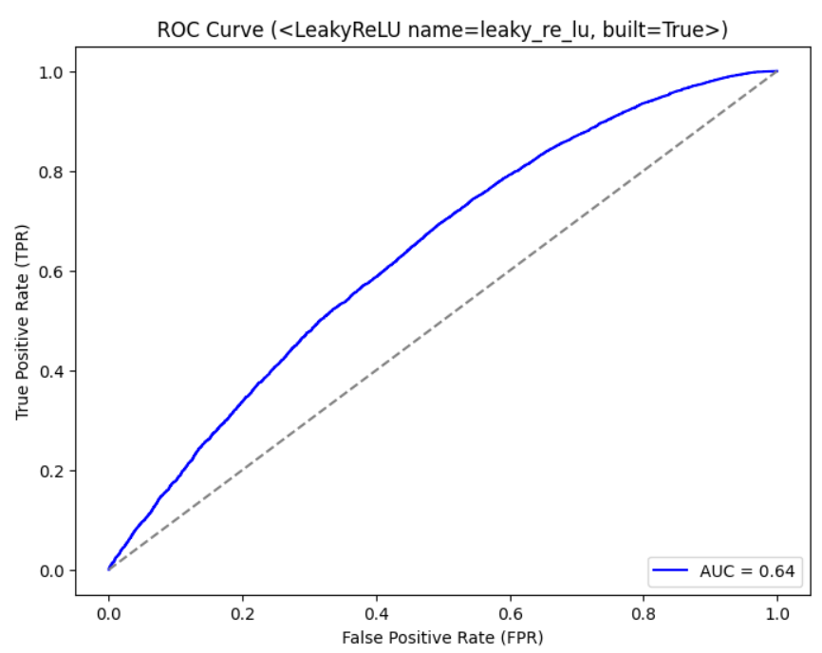
Model Performance Analysis
ANN(Leaky ReLU)

Slide 20
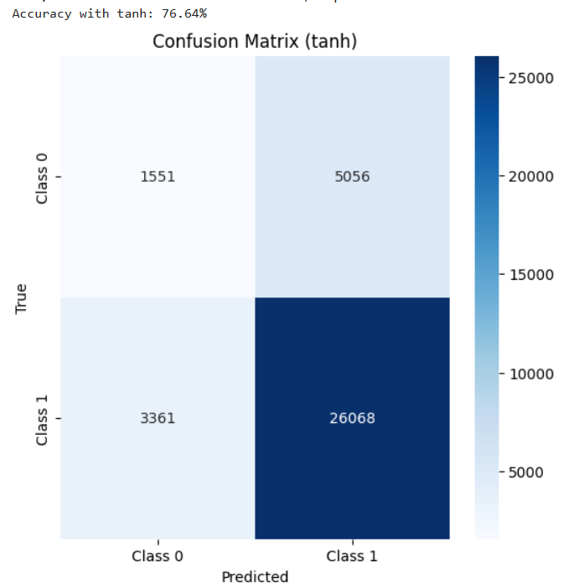
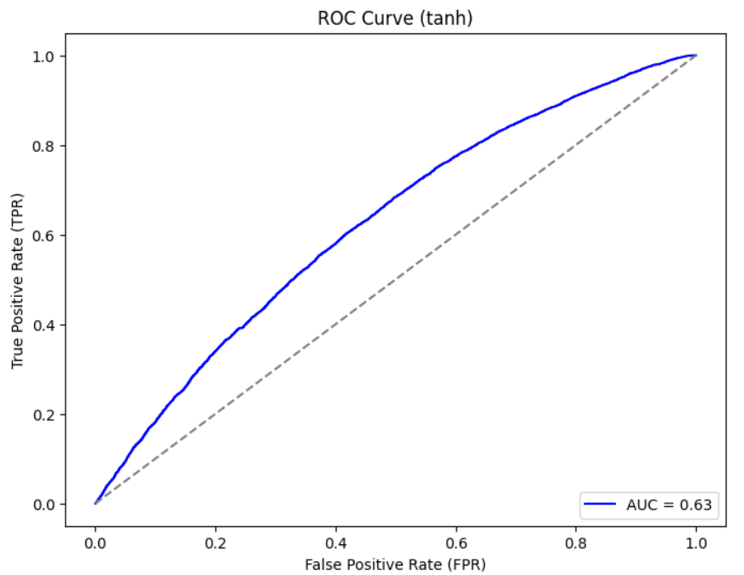
Model Performance Analysis
ANN(tanh)

Slide 21
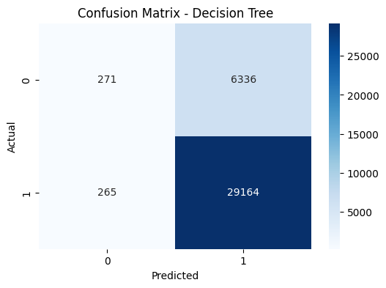
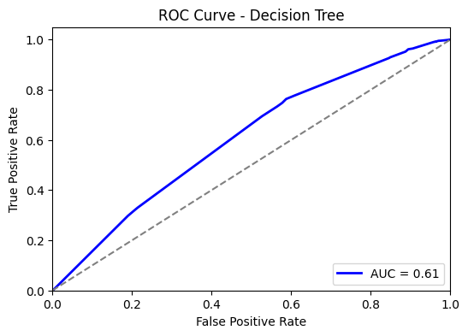
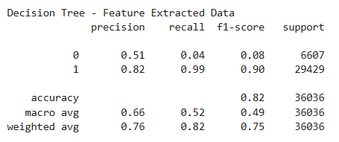
Model Performance Analysis after Hyperparameter Tuning

Slide 22

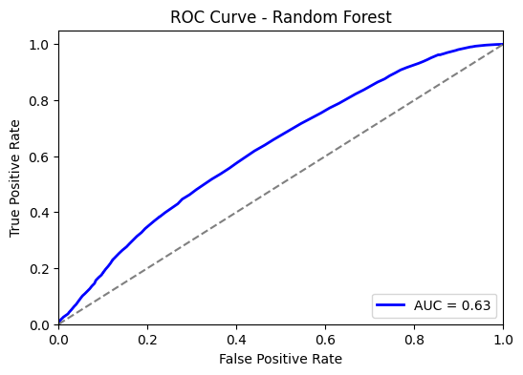
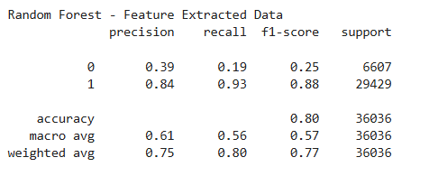
Model Performance Analysis after Hyperparameter Tuning

Slide 23
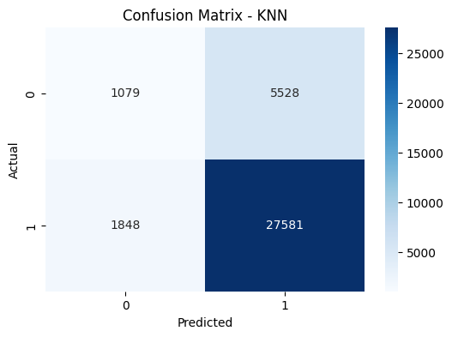
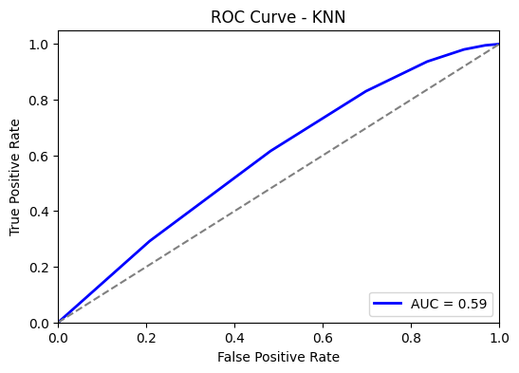
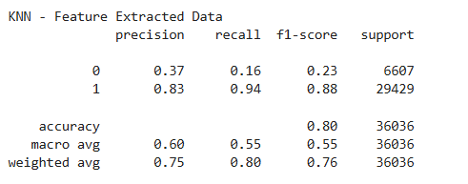
Model Performance Analysis after Hyperparameter Tuning

Slide 24
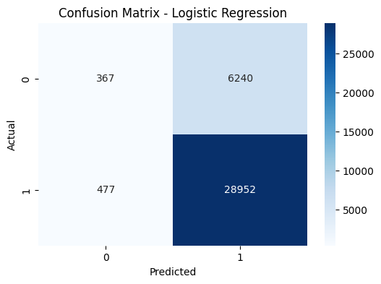
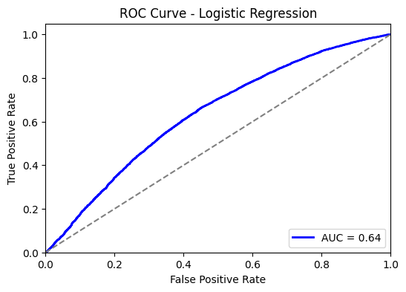
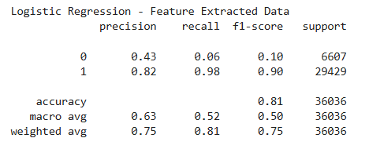
Model Performance Analysis after Hyperparameter Tuning

Slide 25
Model Performance Analysis after Hyperparameter Tuning
Overall Accuracy Increased:
All models improved, with Decision Tree (82%) now performing the best after tuning.
Random Forest & KNN Improved:
Both models reached 80% accuracy, showing better generalization.
F1-score (0.77 for RF, 0.76 for KNN) suggests more balanced predictions.
Decision Tree Shows Significant Gain:
Accuracy jumped from 65% to 82%, indicating better handling of data after tuning.
Precision and F1-score remain competitive, showing a more reliable model.
Logistic Regression Remains Stable:
Accuracy (81%) is consistent, showing robustness.
Balanced F1-score (0.75) and precision (0.75) suggest steady performance.
Algorithm | Accuracy | Precision (Overall) | F1-Score (Overall)
Random Forest | 80% | 0.75 | 0.77
KNN | 80% | 0.75 | 0.76
Decision Tree | 82% | 0.76 | 0.75
Logistic Regression | 81% | 0.75 | 0.75

Slide 26
THANK YOU !

